Slide 1
Finals Week Studying
College Prep
College Prep
Mr. Gordon
jgordon@bisdtx.org

Slide 2
Upcoming Events
Sat. Dec. 4th 6-9- Winter Dance
Tickets are on sale for $8 before 12/1. Nominate someone for Royal Court.
Thurs. Dec. 9th- Last Day of ACC
Fri. Dec. 10th- 11th and 12th A&M College Visit
hi

Slide 3
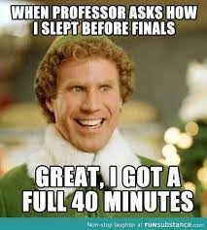
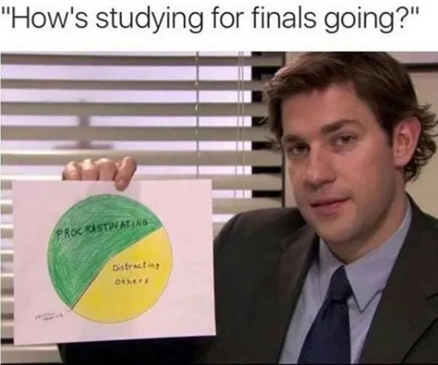
College Prep Assignment
Use this time to study! And enjoy a good meme
hi

Slide 4
College Prep Assignment
In the comments section of today’s College Prep,
answer the following question:
What is your favorite Marvel Comic movie?
hi

